Slide 1
Employee data analysis using excel
Name:Chandru.B
Register No:312219407
Department: III B.com (General)
College : S.A college of arts and science , poonamallee

Slide 2
Project Title
Employee count of employees

Slide 3
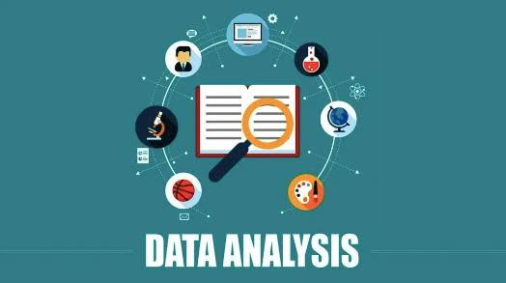

Agenda
Problem Statement
Project Overview
End Users
Our Solution & Preposition
Dataset Description
Modelling Approach
Results & Discussion
Conclusion

Slide 4


Problem Statement
In order to effectively manage workforce resources and make informed strategic decisions, it is crucial to have a comprehensive understanding of employee distribution across various departments and roles within the organization.
The current challenge is to accurately quantify and analyze the number of employees in different categories (such as departments, job titles, and locations) to identify patterns, gaps, and trends. This analysis will help in optimizing resource allocation, forecasting staffing needs, and improving overall organizational efficiency.

Slide 5

Project Overview
Objective: The objective of this project is to systematically analyze and quantify the number of employees within the organization, categorized by departments, job titles, locations, and other relevant criteria. The analysis aims to provide insights into workforce distribution and support strategic decision-making regarding staffing, resource allocation, and organizational planning. Scope: Data Collection: Gather comprehensive employee data from HR systems, including details on departments, job titles, locations, and other relevant attributes. Data Analysis: Employ statistical and data analysis techniques to count and categorize employees based on the collected data. Identify key metrics such as department size, role distribution, and regional staffing levels.

Slide 6


Who are the End users
1. HR Department: Responsible for managing employee records, staffing needs, and organizational structure. 2. Department Heads/Managers: Need insights into employee distribution within their specific departments to manage resources effectively. 3. Senior Management/Executives: Use the analysis to make strategic decisions about staffing, expansion, and resource allocation.

Slide 7

Who are the end users
4. Finance Department: Requires data on employee headcount for budgeting, payroll, and financial planning. 5. Recruitment Team: Uses employee count data to identify hiring needs and plan recruitment strategies.
6. IT Administrators: They could use the data to manage and maintain employee-related systems and software.

Slide 8


Our Solution and Value Preposition
Solution:
1. Data Integration: Centralize employee data from various sources (HR systems, payroll, time tracking) into a unified platform. 2. Real-Time Analytics: Provide dashboards and reporting tools that offer real-time insights into employee metrics, such as headcount, turnover rates, and departmental distribution. 3. Predictive Analytics: Use historical data to forecast future trends in workforce needs and potential gaps. 4. Custom Reporting: Allow users to generate tailored reports based on specific criteria, such as department performance, demographic analysis, or employee tenure.

Slide 9


Our Solution and Value Preposition
Preposition:
Improve Resource Allocation: Optimize the distribution of employees across departments based on current and forecasted needs. Enhance Strategic Planning: Gain insights into workforce trends that support long-term strategic goals. Increase Operational Efficiency: Streamline data management processes and reduce administrative overhead. Boost Employee Satisfaction: Identify and address workforce issues proactively, leading to improved employee retention and satisfaction.

Slide 10

Dataset Description
Dataset Name: Employee Data 2. Description: This dataset contains comprehensive information about employees within the organization, including demographic details, employment history, and departmental assignments. It is designed to support analysis related to workforce size, trends, and other key metrics.
3. Data Fields:
Employee ID: Unique identifier for each employee Name: Full name of the employee. Department: Department in which the employee works. Position/Role: Job title or role of the employee. Date of Hire: The date the employee was hired. Date of Termination: The date the employee left the company.

Slide 11
Dataset Description
4. Data Source:
HR Management System: Primary source for employee information. Payroll System: For salary and employment status data. Time Tracking System: For work hours and attendance data. 5. Data Collection Frequency: Updates:Monthly or quarterly updates to reflect changes in employee data. 6. Data Format: File Type: CSV, Excel, or database format. Data Encoding: UTF-8.

Slide 12
Modelling approach
1. Predictive Analytics : Use regression models or machine learning algorithms to predict outcomes like employee turnover or performance. Techniques like logistic regression, decision trees, or random forests can be useful here. 2. Clustering : Group employees based on characteristics or behaviors. K-means clustering or hierarchical clustering can help identify patterns or segments within your data. 3. Descriptive Analytics : Use statistical methods to describe the current state of employee data. Measures like averages, standard deviations, and correlations can provide insights into employee satisfaction, performance, etc.

Slide 13
Modelling approach
4. Survival Analysis : If you’re interested in understanding the time until an event occurs (e.g., employee attrition), survival analysis methods like Cox proportional hazards models could be useful. 5. Time Series Analysis : If you have data over time, you could use time series analysis to identify trends and patterns in employee metrics.

Slide 14
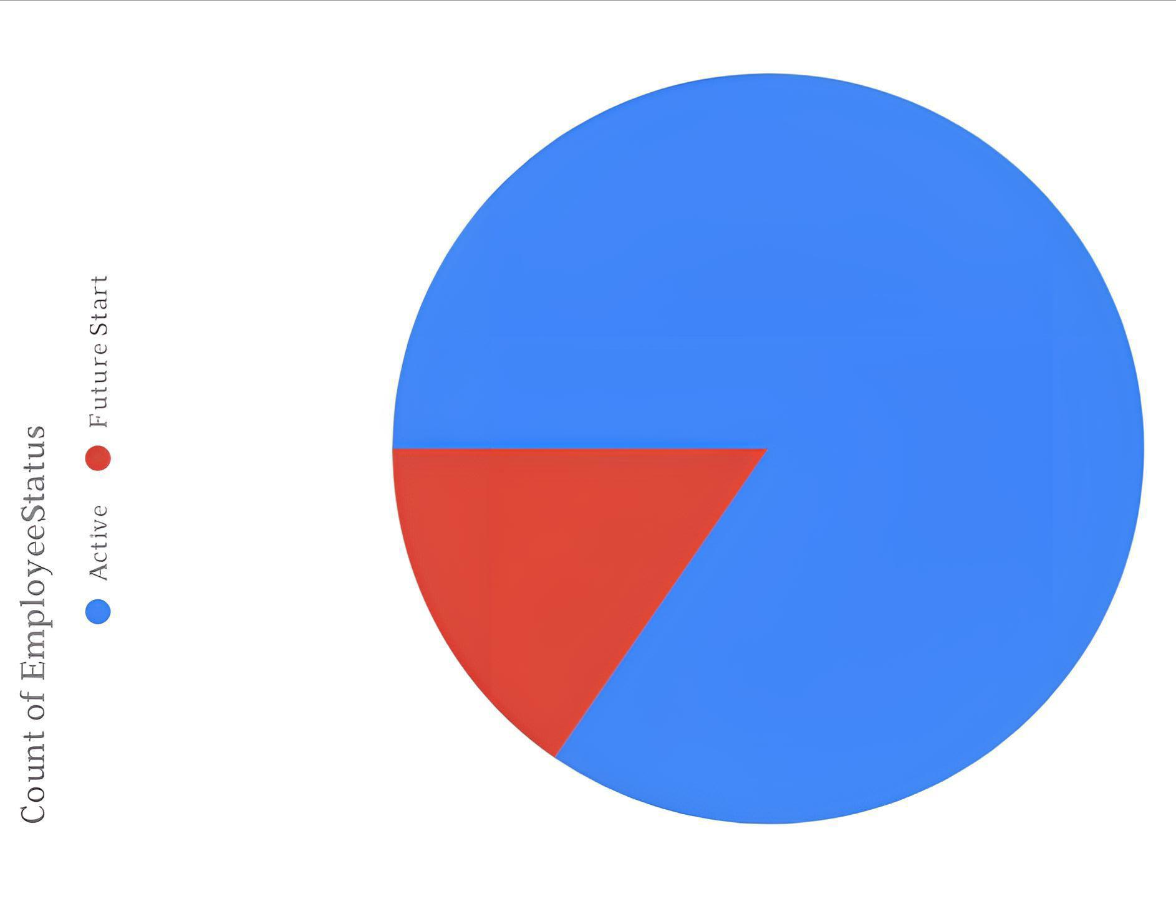
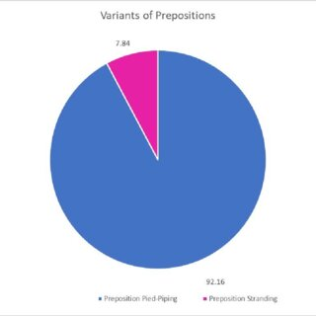
Result:
Employee
Status Analysis Using Chart

Slide 15
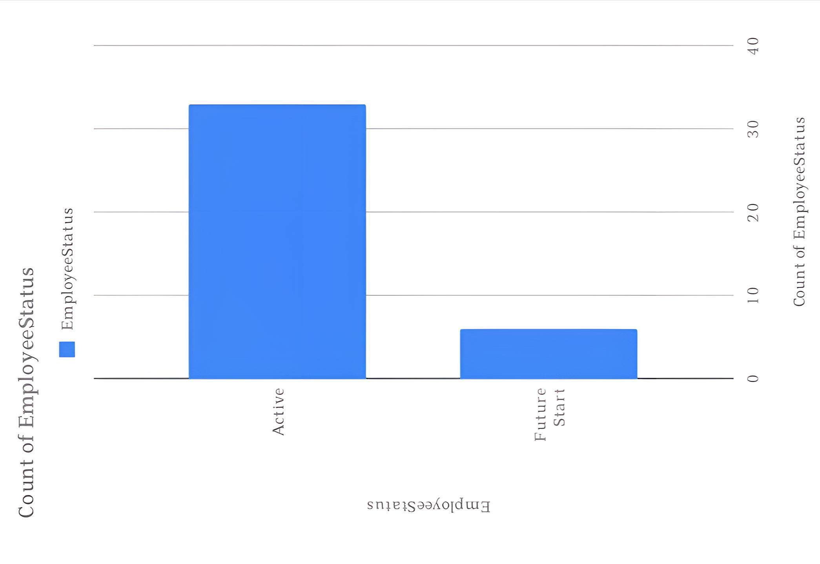
Result:
Employee
Status
Using
Chart

Slide 16
Conclusion
This project has provided valuable insights into employee dynamics through comprehensive data analysis. Key findings include, which indicate [implications of these findings]. These insights contribute to a deeper understanding of [specific aspect of employee data] and offer practical recommendations for [specific actions]. However, limitations such as [mention limitations] should be considered when interpreting the results. Future research could focus on [suggest future research areas], to build on these findings and further enhance our understanding of employee behavior.

